Slide 1
Conversation
Value of art
Curious
Play to win or play to keep the game going?
Unlikely?
Girl & boy animation
Christopher bAUMAN

Slide 2
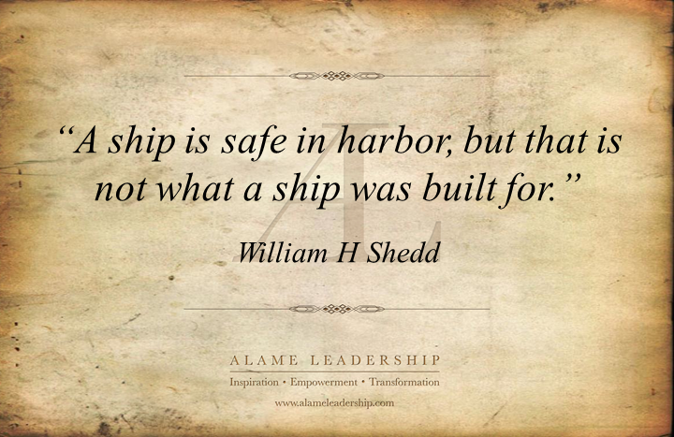
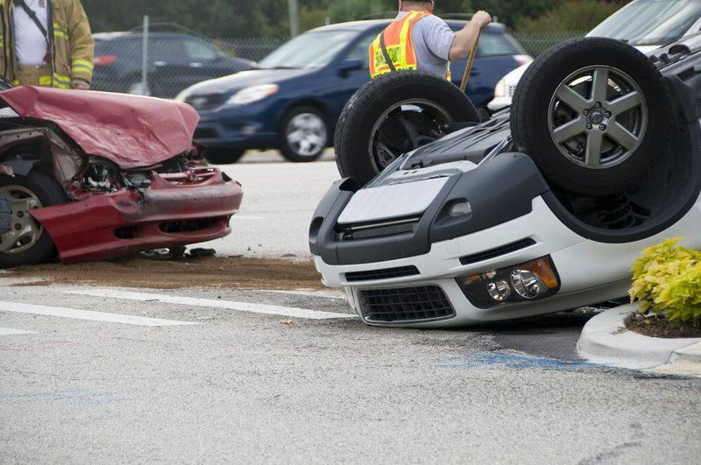
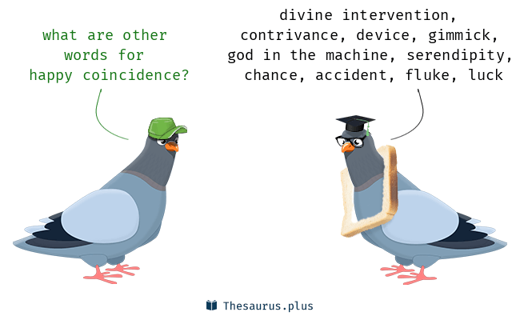
Education Infographic
Risk
Chris Bauman

